Slide 1


Snoonu Merchant Intelligence Platform by Snoonunation

Slide 2

Snoonu merchants struggle to understand what actions actually grow their business
No Decision Support
Data Overload
Mission Growth Layer
Low Campaign Adoption
Limited Time & Expertise
Problem
Evidence
Solution
System
Prototype
Impact
Scale
Vision

Slide 3
Global delivery platforms actively invest in merchant support, analytics, and growth guidance
Industry Research
Platform Impact
Customer & Revenue Impact
Problem
Evidence
Solution
System
Prototype
Impact
Scale
Vision

Slide 4
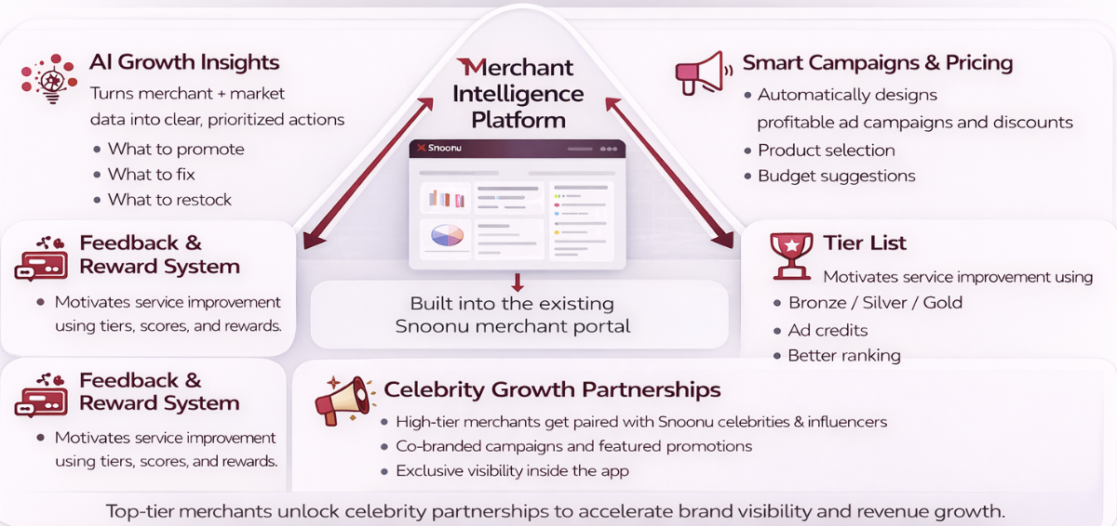
Merchant intelligence acts as a growth operating system that guides merchants step by step
Problem
Evidence
Solution
System
Prototype
Impact
Scale
Vision

Slide 5
The system transforms performance data into prioritized, high-impact actions for merchants
Problem
Evidence
Solution
System
Prototype
Impact
Scale
Vision

Slide 6
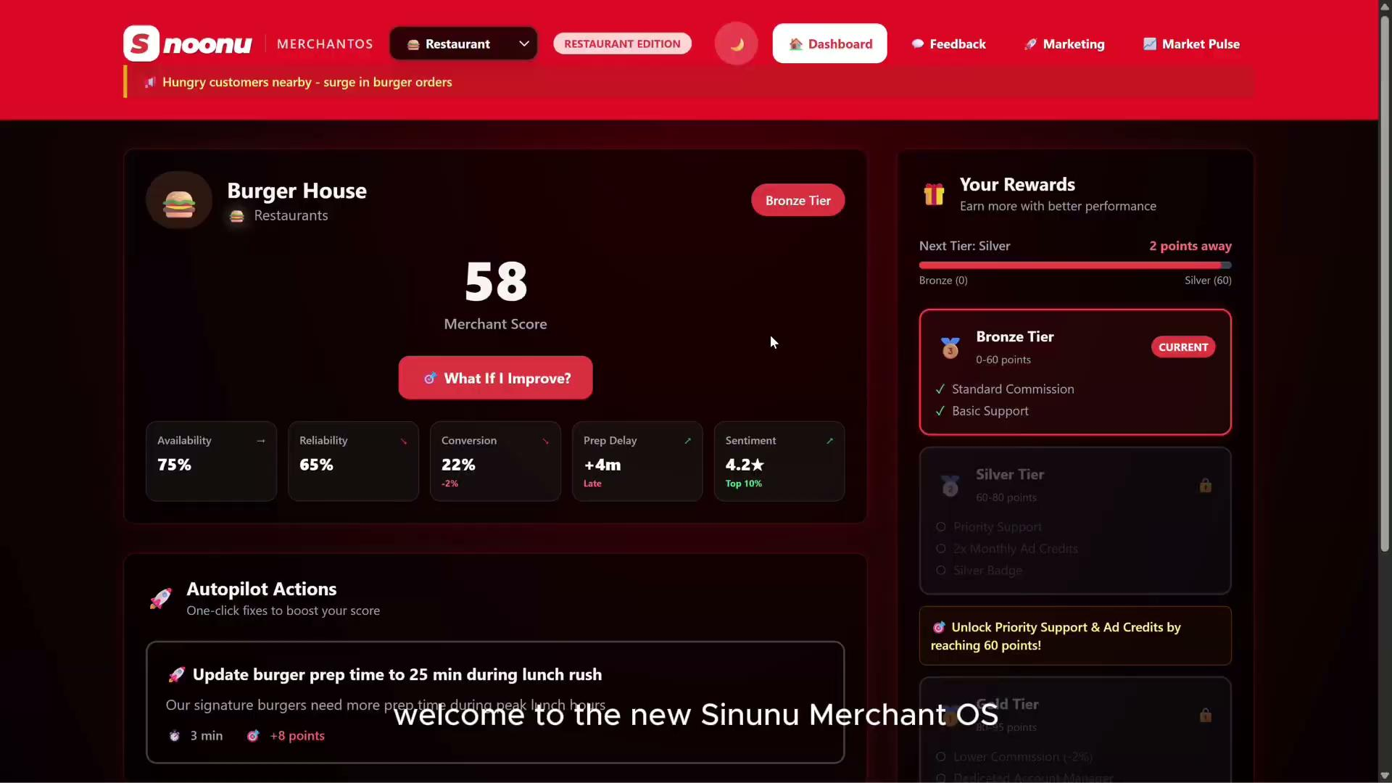
Our prototype shows how merchants identify problems, take action, and measure impact
Problem
Evidence
Solution
System
Prototype
Impact
Scale
Vision

Slide 7




Success is measured through merchant adoption and platform-level performance improvements
Campaigns per Merchant
Average Order Value
Revenue Growth
Cancellation Rate
Problem
Evidence
Solution
System
Prototype
Impact
Scale
Vision

Slide 8
The solution integrates with Snoonu’s existing data systems and can scale incrementally
Data Foundation (MVP)
Guided Adoption
Autonomous Layer
Autonomous Growth Engine
Platform Integration
Problem
Evidence
Solution
System
Prototype
Impact
Scale
Vision

Slide 9
This system transforms Snoonu from a marketplace into a growth partner for merchants
Snoonu Today
Transaction Focused
Limited Merchant Guidance
Reactive Support
Revenue Driven by Volume
Snoonu Tomorrow
Growth Partner for Merchants
Data Guided Decisions
Proactive Optimization
Revenue Driven by Merchant Success
Problem
Evidence
Solution
System
Prototype
Impact
Scale
Vision

